Slide 1
Bayesian Hierarchical Models for Loss Development
Michael Cooney, Jake Morris and Cynon Sonkkila
Notes:
De-mystify modern Bayesian methods
Illustrate potential useful applications in general insurance actuarial work
Show how you (actuaries) can get started

Slide 2
Introduction to Bayesian methods
“Modern Bayesian methods provide richer information, with greater flexibility and broader applicability than 20th century methods.
Bayesian methods are intellectually coherent and intuitive …[and] readily computed...”
John K. Kruschke
Notes:
Why would we want to use Bayesian methods?

Slide 3
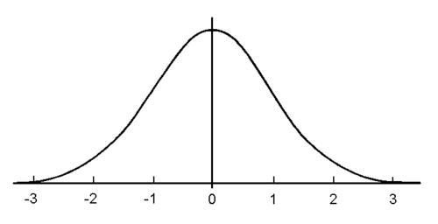
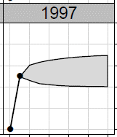
Introduction to Bayesian methods
Actuarial work is fundamentally assumptions-based:
Data + Models + Judgements = Predictions
Key challenge: updating assumptions as new information arises
To what extent should we react? Are we consistent?
Are existing assumptions still relevant?
Assumptions
Assumptions
Notes:
- Prediction = some combination of data, models and judgement
- Models + Judgements rely upon assumptions…
- Predictions often become new assumptions, which are used to inform new predictions
---Plan / pricing loss ratios, est. # large losses, development patterns…
Are dev. Patterns shifting? Is our IELR irrelevant now? To what extent are ranges of uncertainty shrinking?

Slide 4
Introduction to Bayesian methods
Standard actuarial problems → credibility theory:
OK, but we might also like…
Z to incorporate actuarial judgement
Greater model flexibility, e.g. nonlinearities, autocorrelation, …
Uncertainty estimates:
“Given [our] estimate of future payments and … current state of knowledge, what is the probability that final payments will be no larger than the given value?”
Notes:
- A credibility factor Z can be used to weight between an individual result and some wider average
- Credibility factor will usually reflect data quality and/or quantity
- Can also be used to update estimates/assumptions
- Small adjustment of formula gets us to the BF method
- Complex models?

Slide 5



Introduction to Bayesian methods
Bayes’ theorem (probability):
Bayes’ theorem (inference):
For actuaries:
Events
RVs (Data are fixed)
Posterior ∝ Prior x Likelihood
ULR unknown & probability modelled
Notes:
- Brief intro
- Mick for detailed application of Bayesian methods for modelling loss development

Slide 6
Introduction to Loss Development models

Slide 7
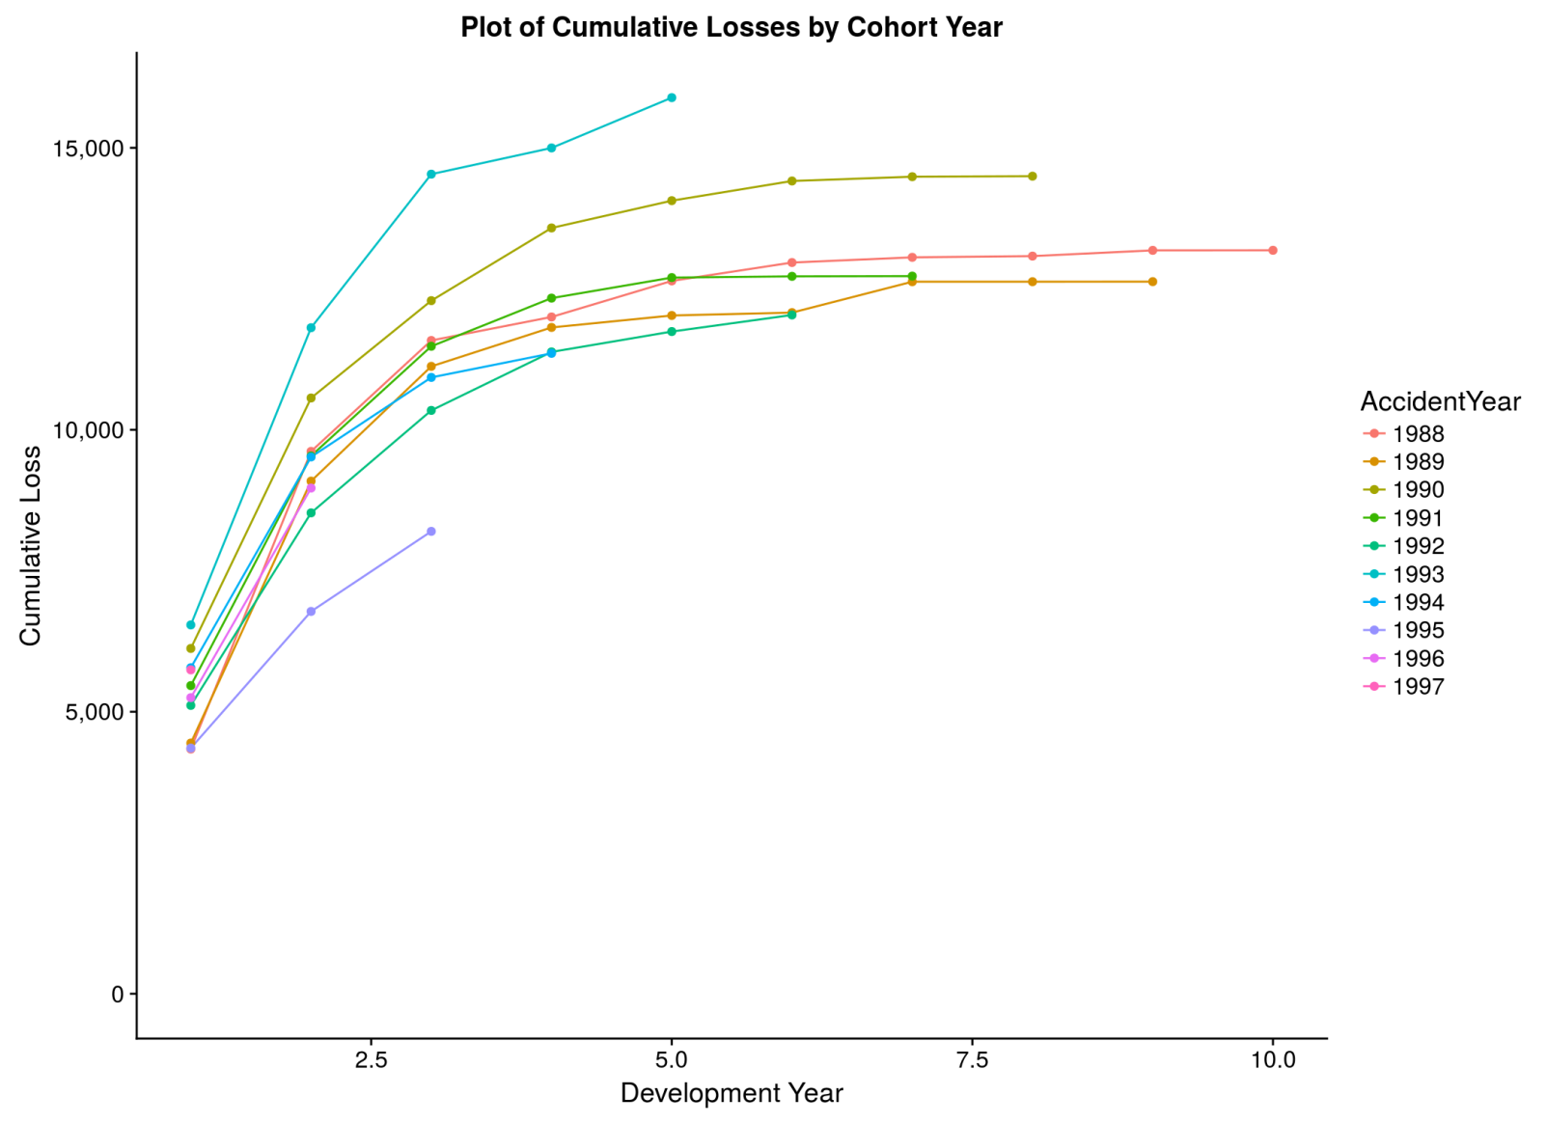
Cumulative losses by Cohort Year

Slide 8
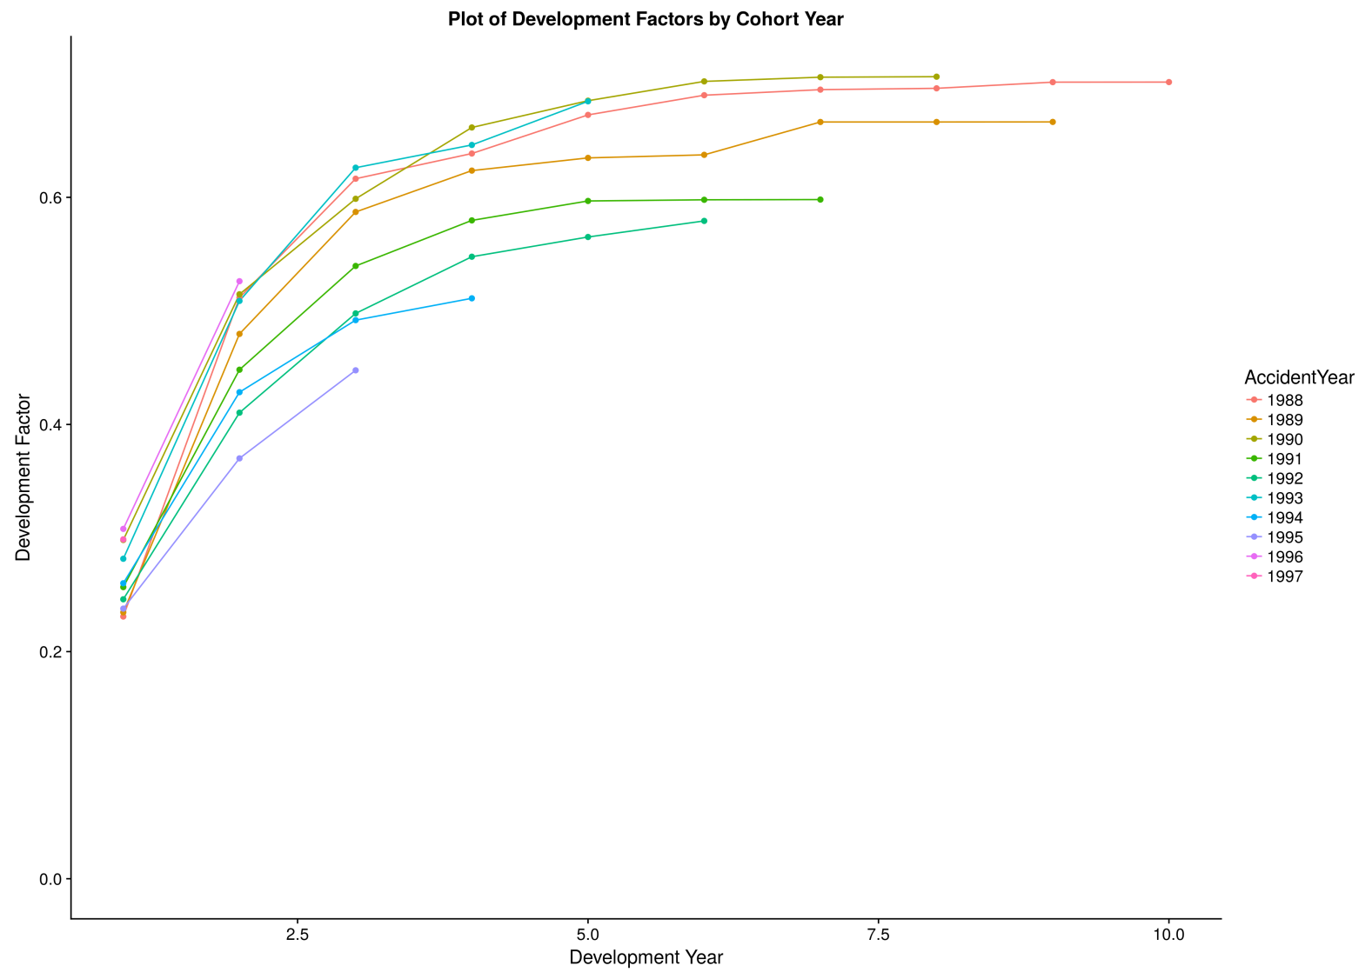
Development factors by Cohort Year

Slide 9
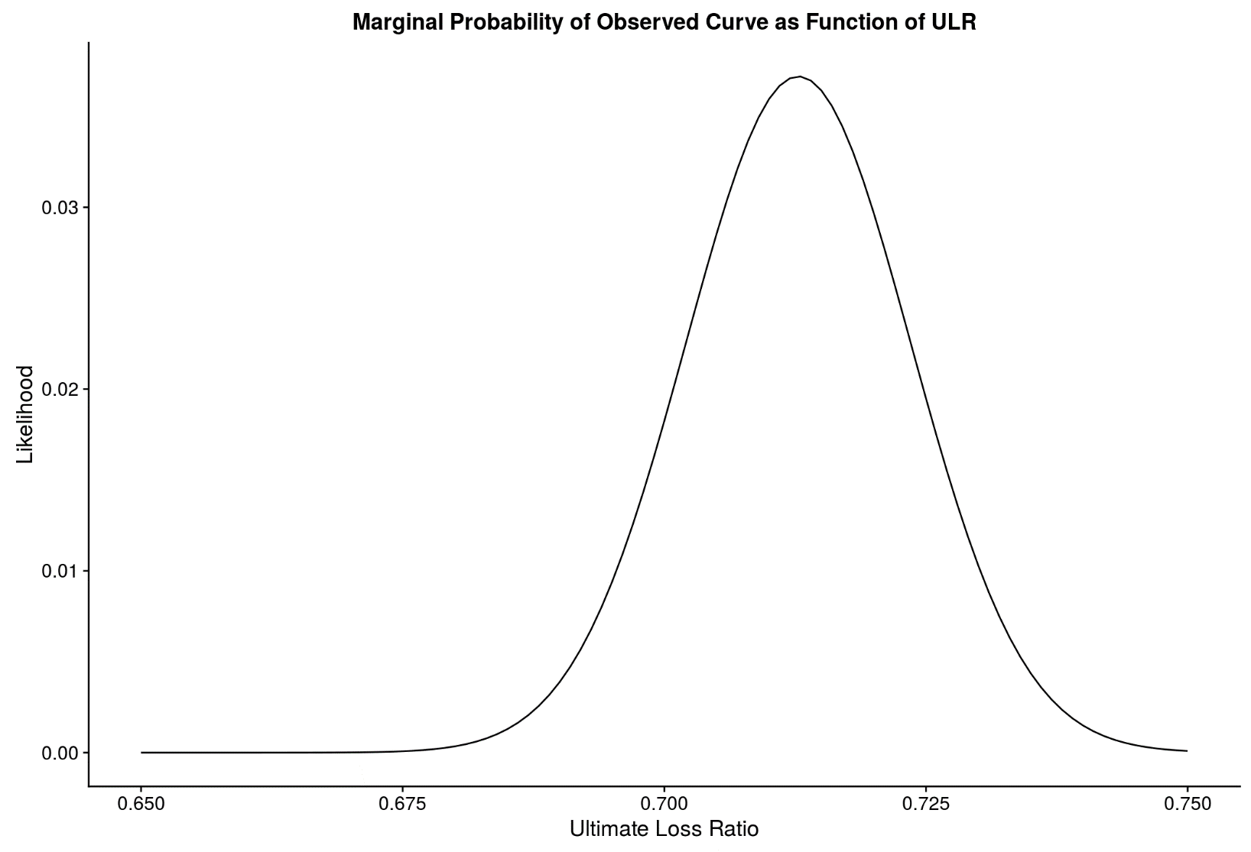
Grid Approximation

Slide 10
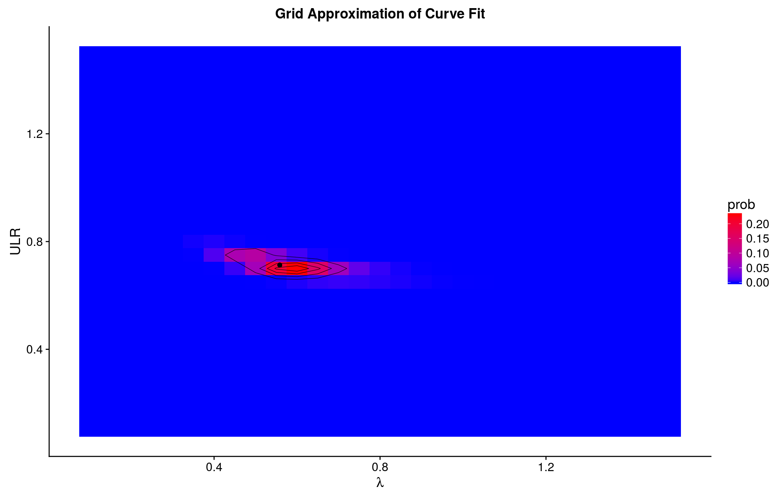
2D Grid Approximation

Slide 11
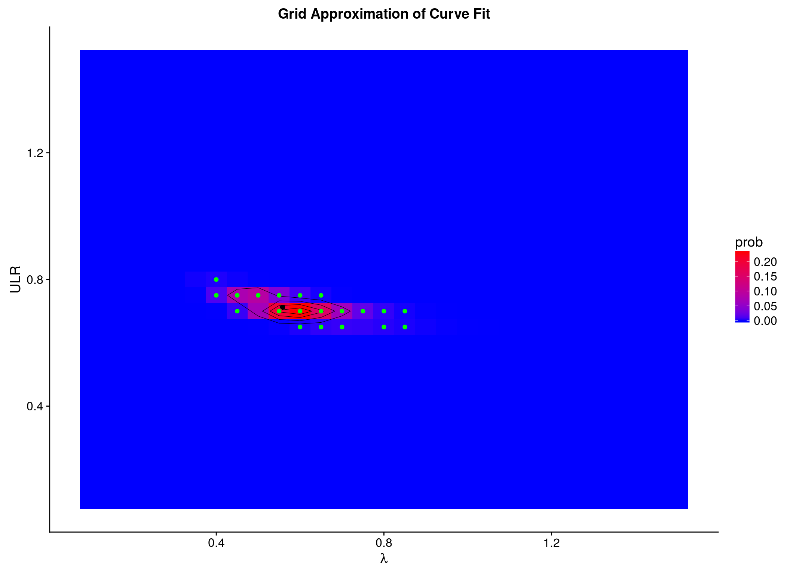
2D Grid Approximation

Slide 12
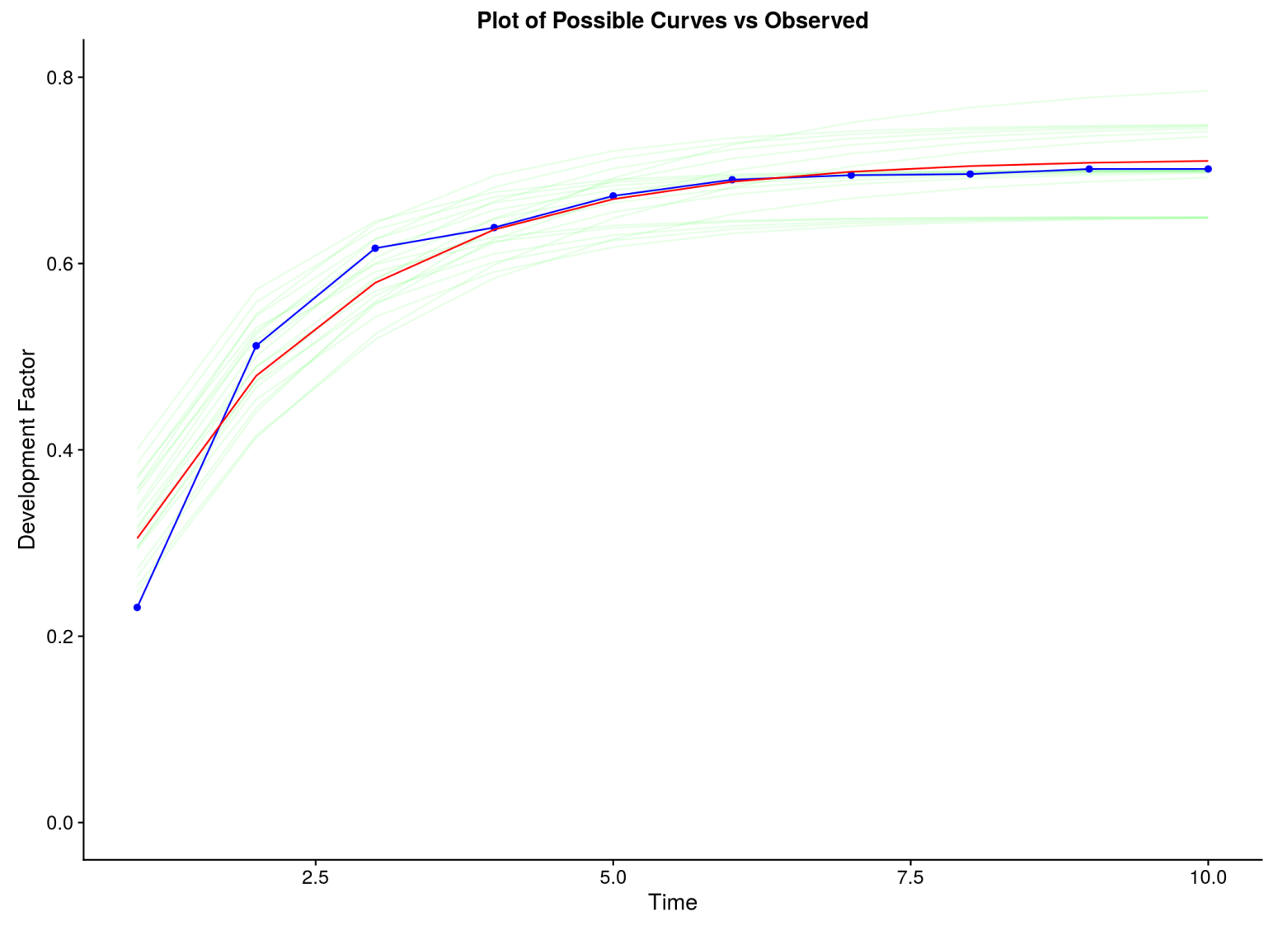
Observed vs Fitted Development Curves

Slide 13
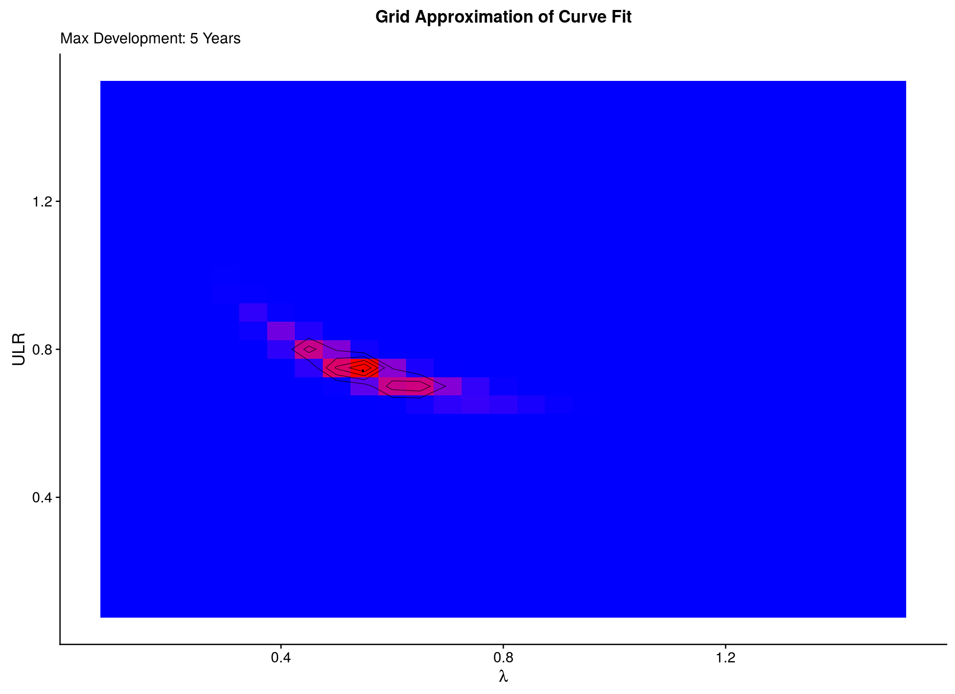
5 Years Of Development Only

Slide 14
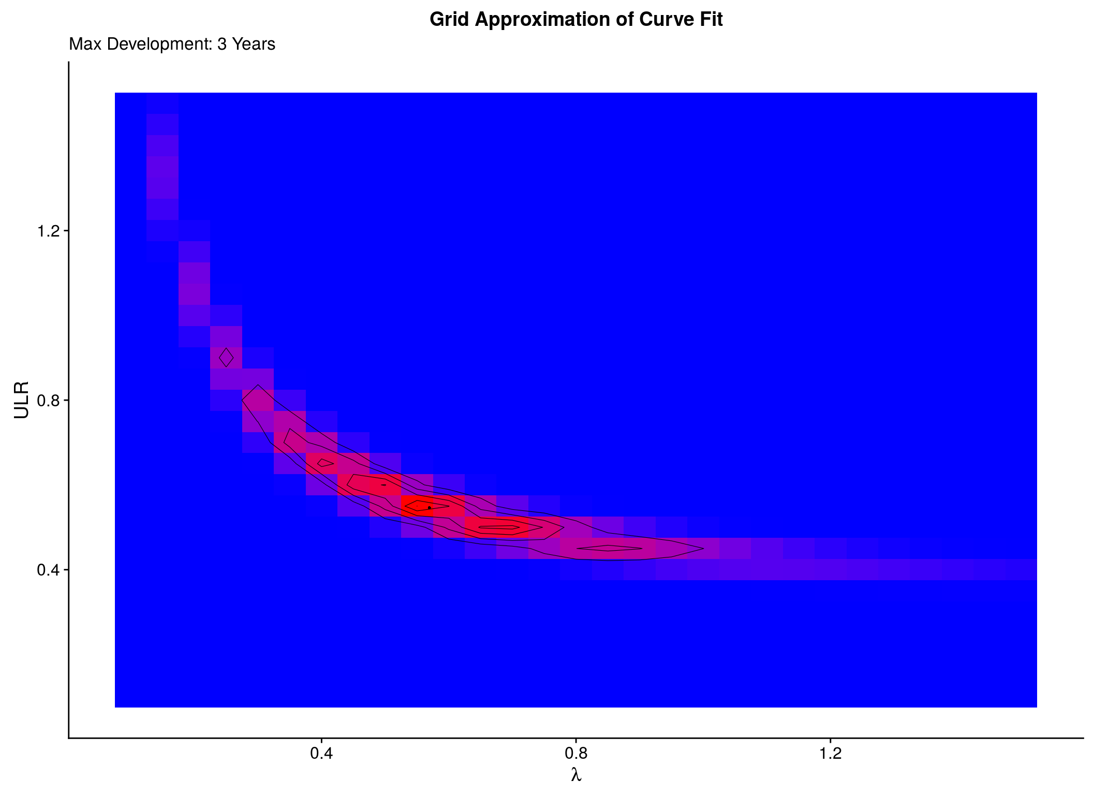
3 Years of Development

Slide 15
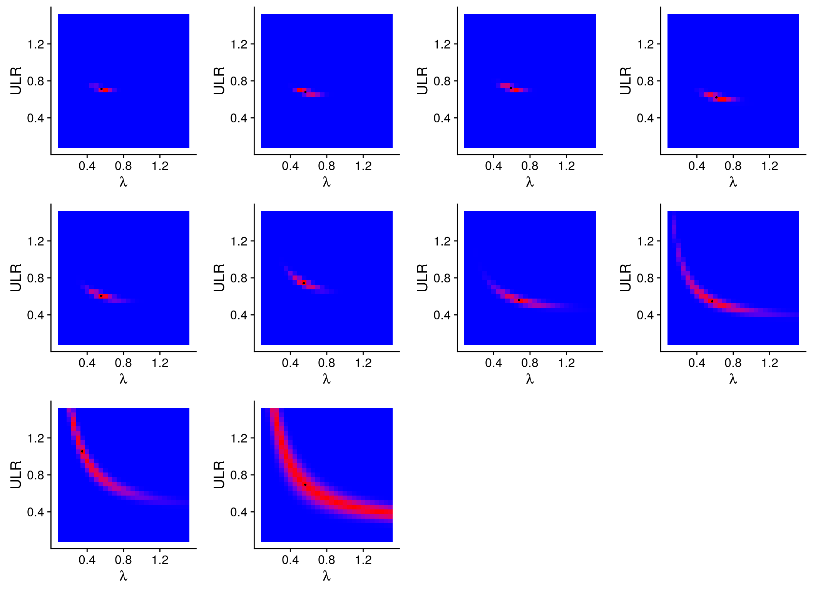
Different Accident Years

Slide 16
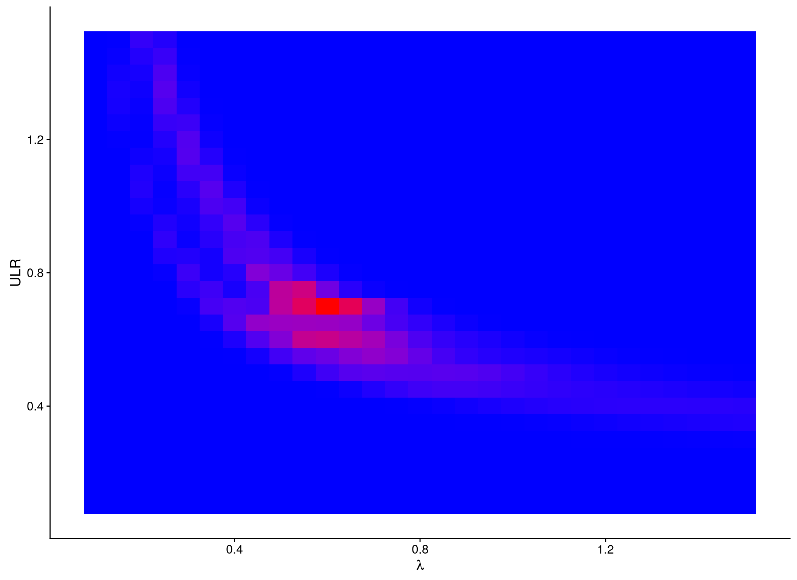
Sum of all Accident Years

Slide 17
Specifying the Model
Loss(t) = Premium × Ultimate Loss Ratio × GF(t)
Model growth function as Weibull or Log-logistic
Hierarchy by year

Slide 18

Posterior Sampling
High-dimensional integrals
Computationally infeasible
Sample instead
Stan (mc-stan.org)
Hamiltonian Monte Carlo

Slide 19
Full Model Specification
Loss(Y,t) ∼ Normal(μ(Y,t), σ_{Y})
μ(Y,t) = Premium(Y) × LR(Y) × GF(t)
σ_{Y} = Premium(Y) × σ
LR_{Y} ∼ Lognormal(μ_{LR},σ_{LR})
μ_{LR} ∼ Normal(0,0.5)

Slide 20
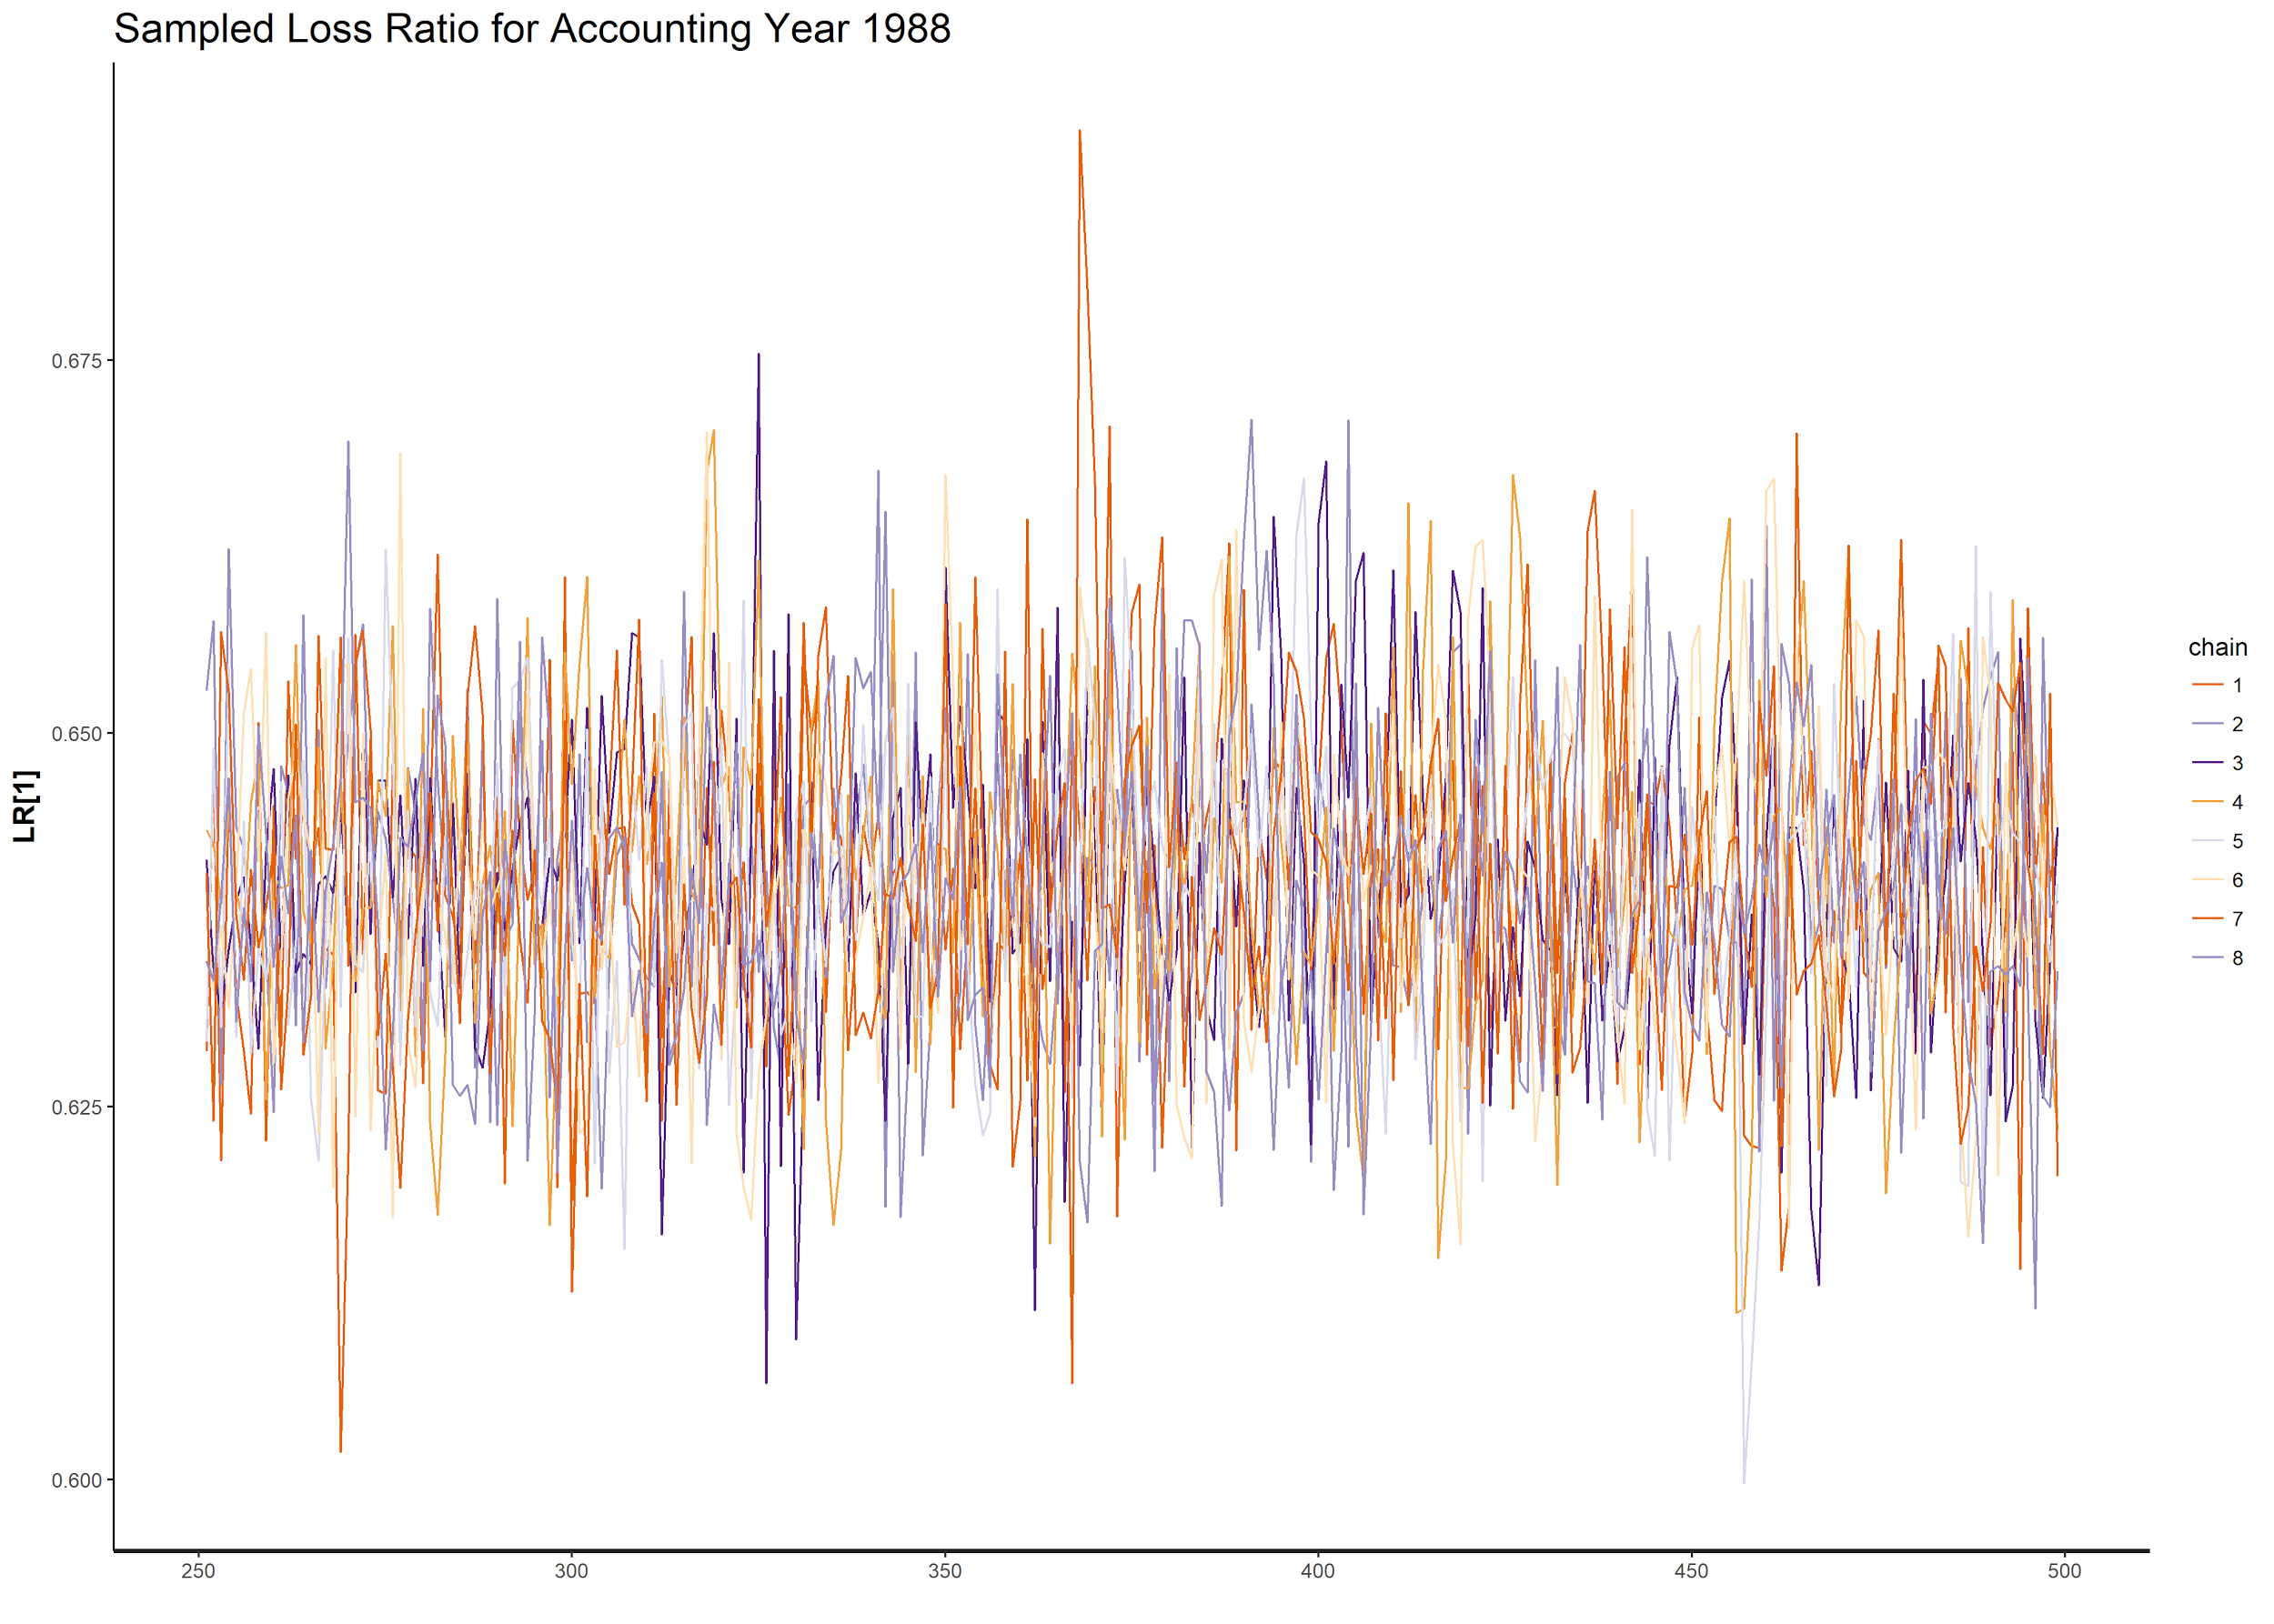
Outputs of MCMC

Slide 21
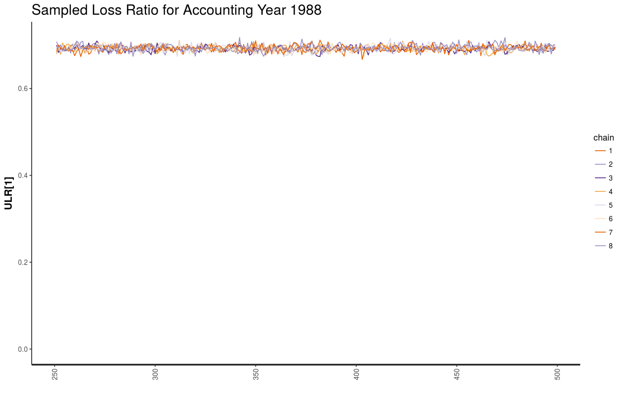
Outputs of MCMC

Slide 22
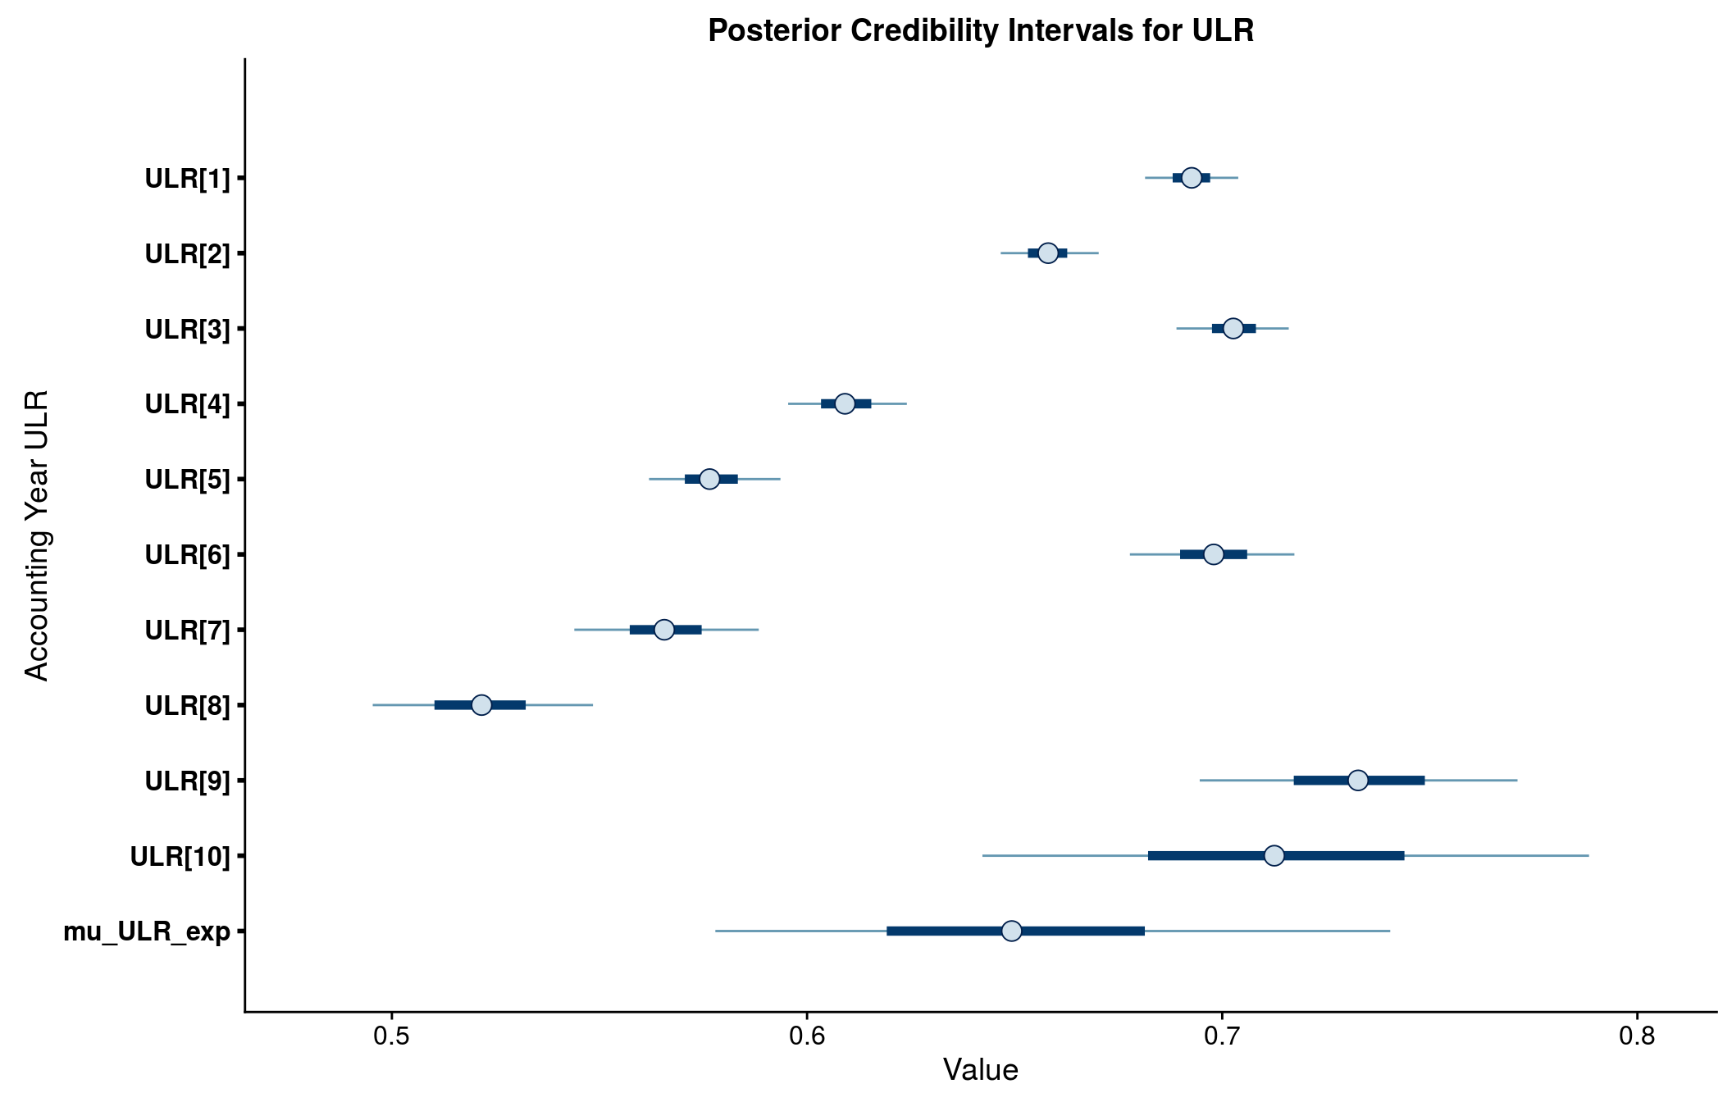
Parameter Inference

Slide 23
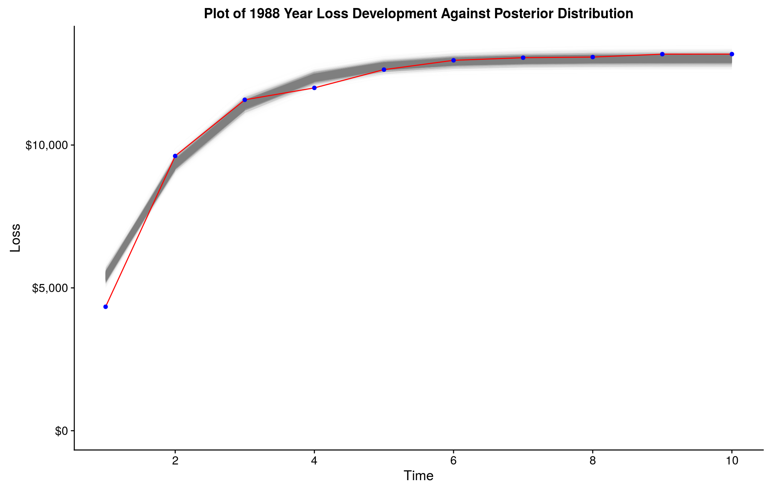
Sanity Check for 1988

Slide 24
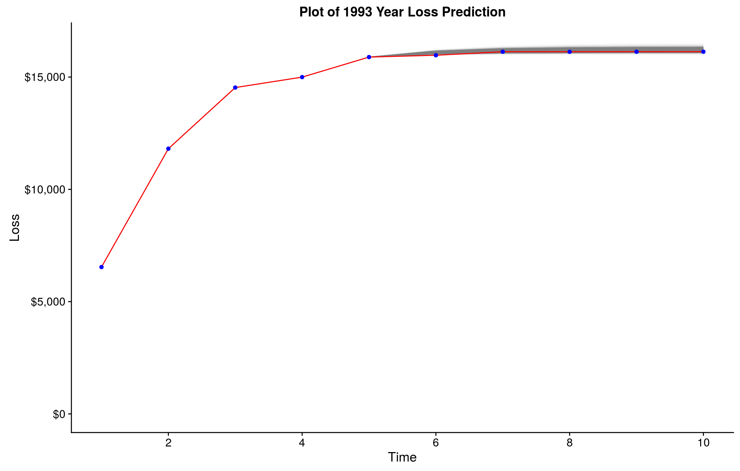
Predictions for 1993

Slide 25
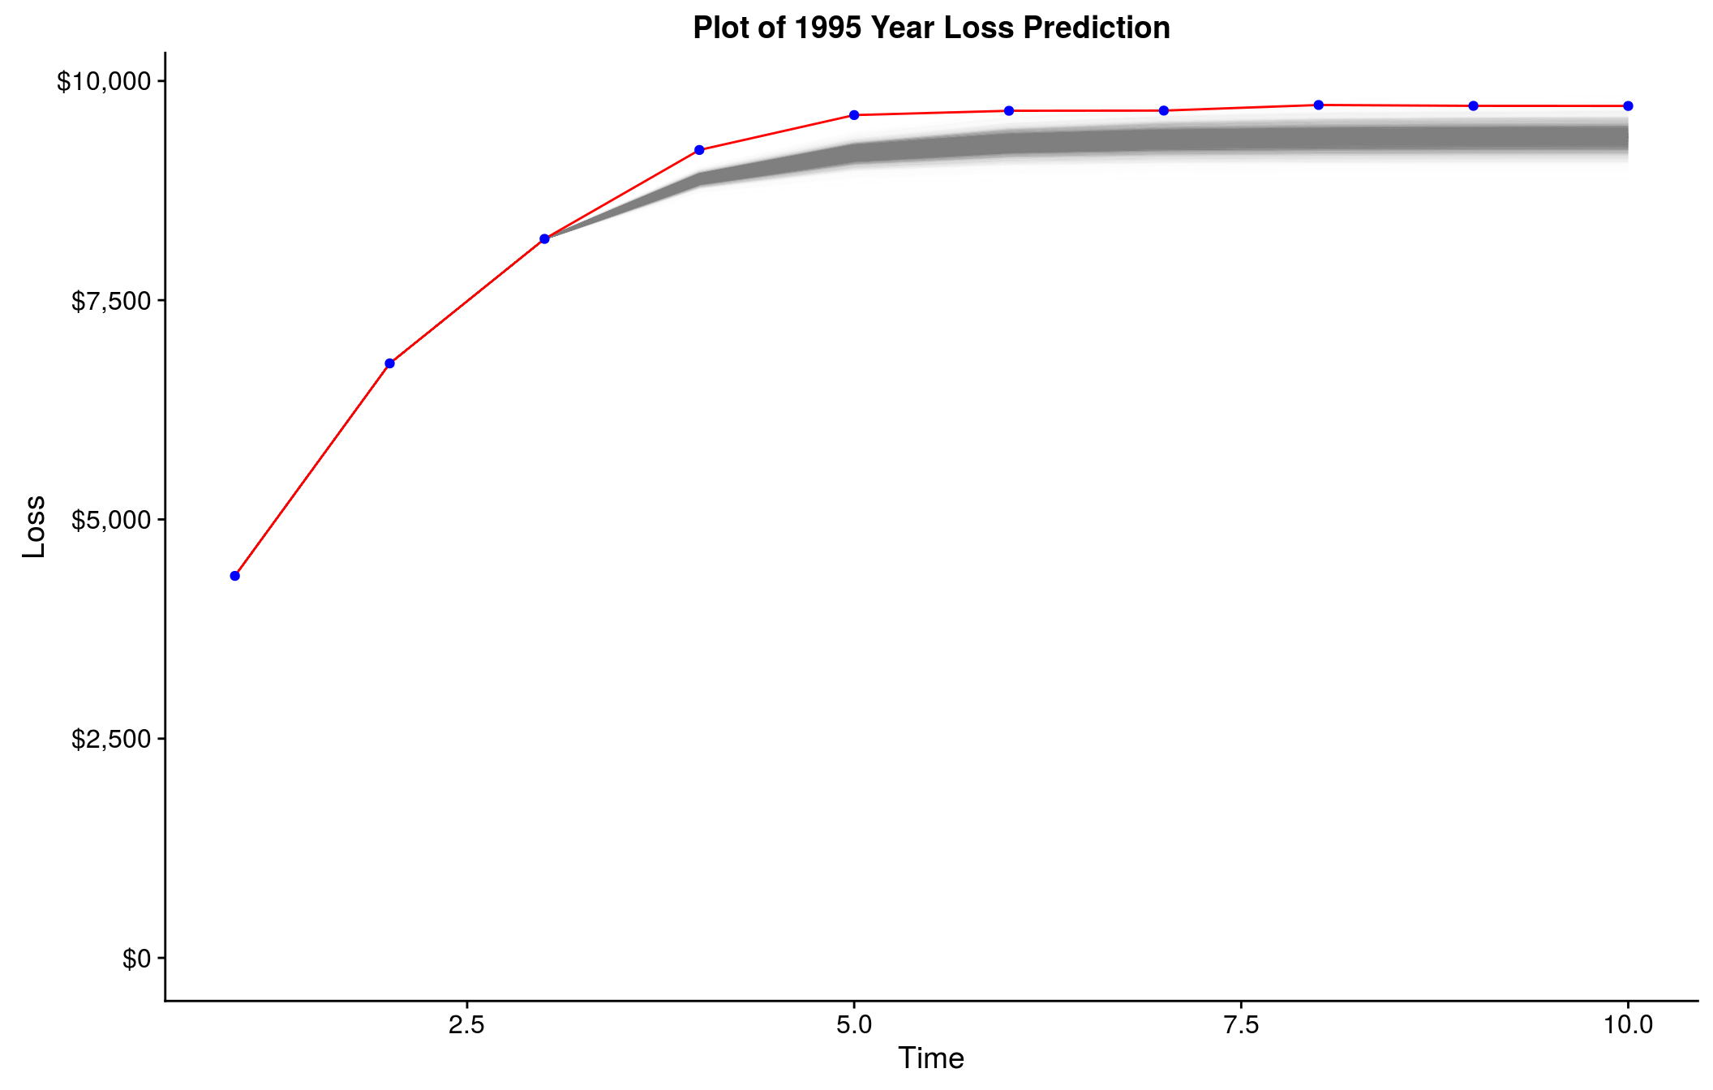
Predictions for 1995

Slide 26
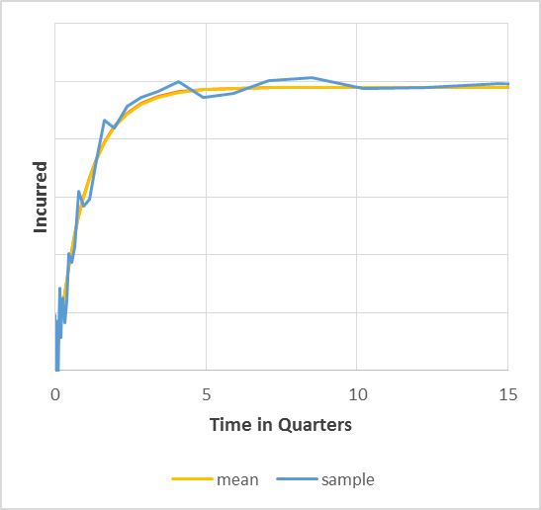
Recap
We have seen how a time varying development pattern can be approximated using a CDF like curve.
Relatively low number of parameters are needed.
The example shown is for:
an exponential CDF fit
2 parameters: Ultimate and Lambda.
 | Incurred = Ultimate*(1 − e^{−λ* time} )

Slide 27
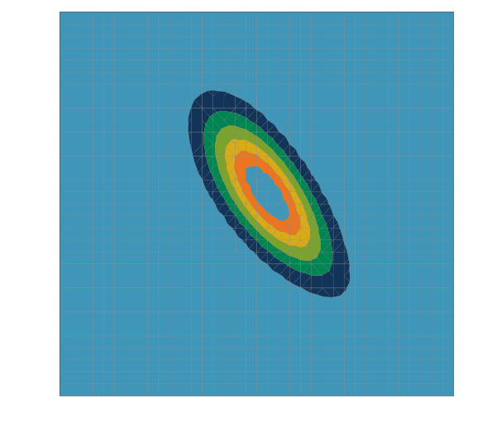
Recap
Parameter Uncertainty can be represented using the likelihood function (of MLE fame).
Presented here on a grid.
MLE would be in the centre.

Slide 28
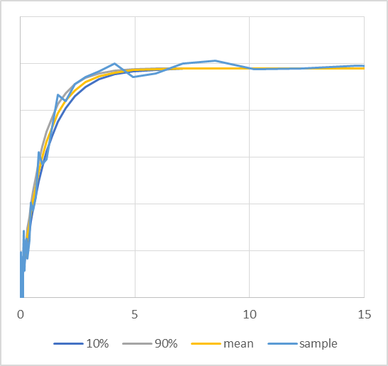
Recap
Sampling is conducted on the Likelihood distribution
Sample development curves give an envelope of reasonable development patterns that fit the data.

Slide 29
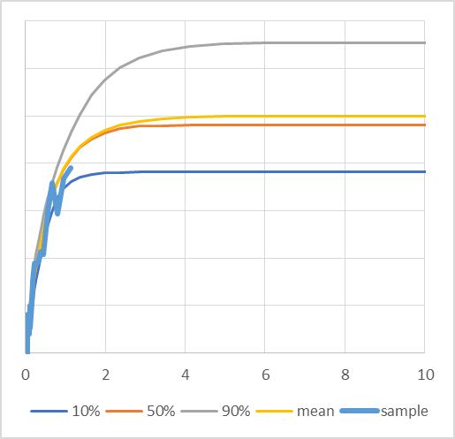
Recap
Less data creates more uncertainty.

Slide 30
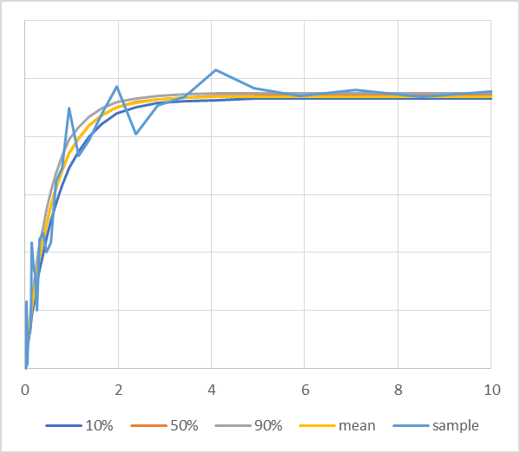
Recap
More data creates less uncertainty.

Slide 31
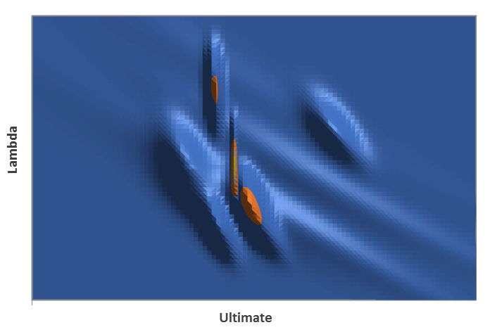
Recap
Sharing credibility from year to year is incorporated using a prior.
One method is to think of the prior years as samples “what might happen” for a new year.
So the “sum” of previous years is a suggestion for a new year i.e. a prior.
14 years of data shown here as an example.
Perhaps there is a better way?

Slide 32
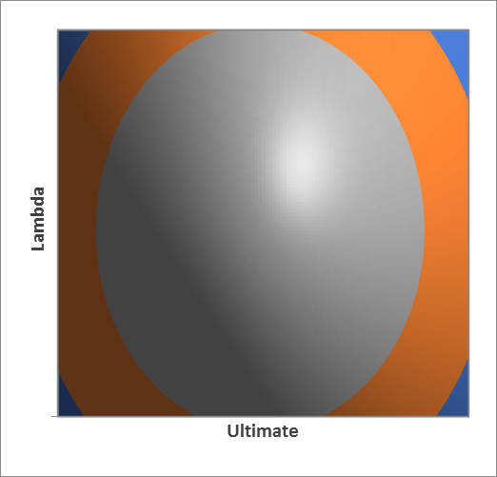
Recap
The prior is better approximated as a smooth distribution.
A lognormal prior for Lambda and Ultimate are shown here.
The prior can be fitted as part of a hierarchical model.

Slide 33
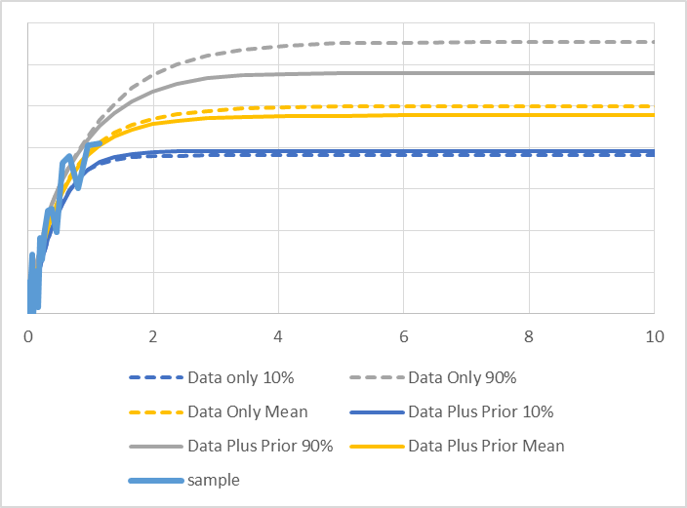
Recap
Applying a prior based on other years lends credibility to a year with limited samples.
Reduced mean and spread can result when a combination of the prior and data are used to estimate the range of reasonable ultimates.

Slide 34
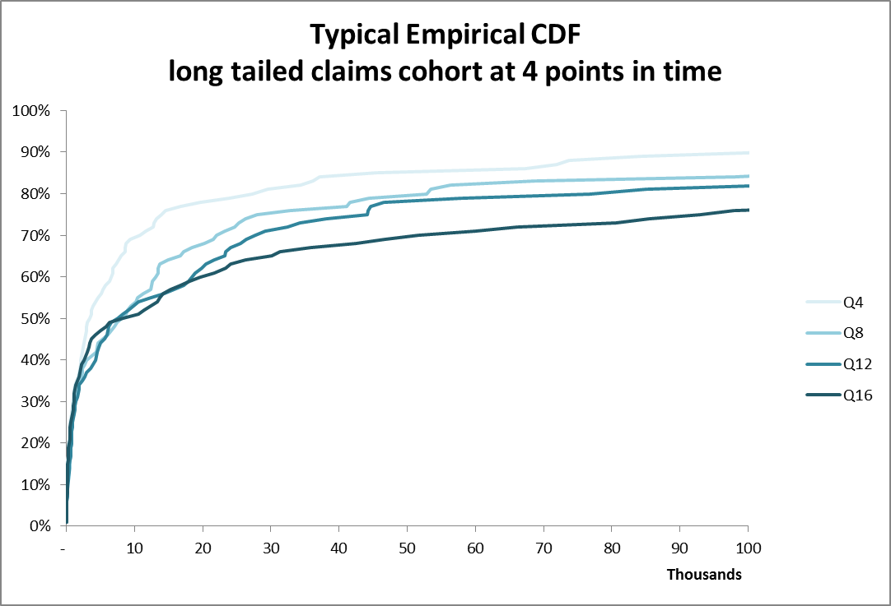
Extensions
Instead of tracing the path of “incurred” development we can trace the path of some other parameters.
Opposite is the path of a typical AY cohort of 100 claims as they develop.
Mean and standard deviation tend to increase with time as heavier claims are reported later.

Slide 35
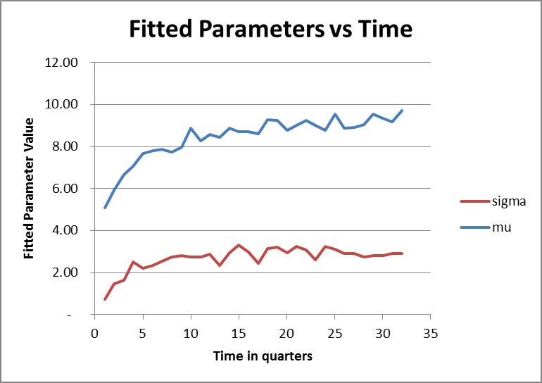
Time series of fitted parameters
This behaviour can be represented as a trend in the fitted parameters.
Here we fit a lognormal at each point in time and plot the parameters.
Mu and Sigma trend much like a development curve.

Slide 36
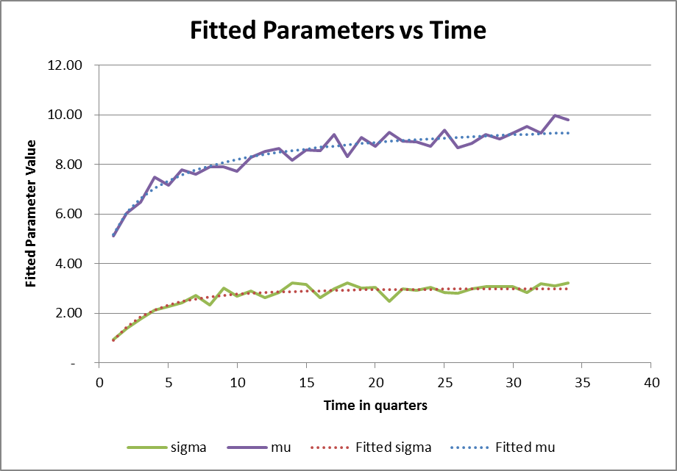
Time series regression
This behaviour can be modelled with a growth curve.
Here mu and sigma are fitted using a lognormal CDF with a start and end parameter.
For example:
Mu = start + (end-start)* LNCDF(mu_{development},sigma_{development})
In this case the “ultimate” distribution of claims are given by the ultimate mu and sigma (the “end” parameter).

Slide 37
Time series regression
Such a model does not require development factors.
Bayesian techniques are best used to estimate mu and sigma.
The ultimate expected mu and sigma are then given with parameter uncertainty.
Recent years where there is limited data would utilise a credible prior based on previous years as before.

Slide 38
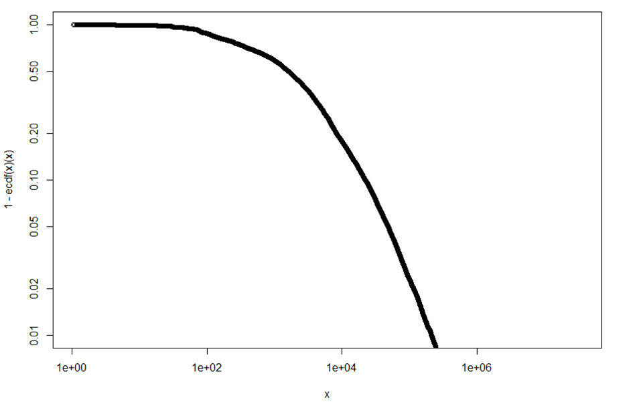
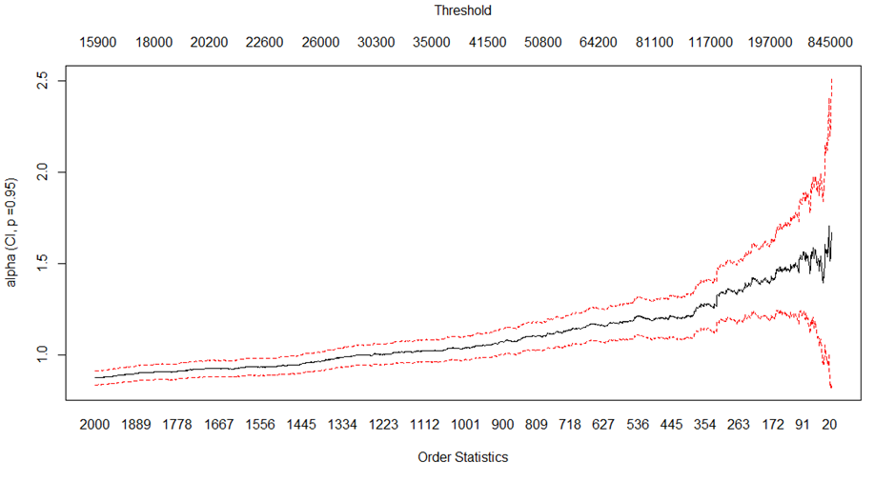
Further extensions to treat extreme events
Some loss data may be described using Extreme Value Theory type distributions.
A typical plot is a log-log survival plot or Hill plot shown opposite.
Linear behaviour on the upper plot would better be modelled by a Pareto distribution.
A Hill plot (lower right) would show stable fitted alpha above some level.

Slide 39
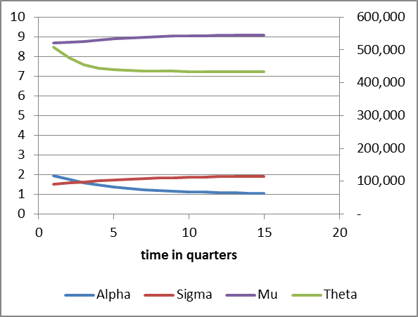
Fitting a Lognormal-Pareto distribution
The method for fitting a lognormal distribution with a Pareto tail is outlined by Teodorescu, S. (2009).
The model has three parameters:
Alpha, the Pareto distribution parameter
Theta, the level at which the Pareto distribution will be fitted
Sigma, one of the lognormal parameters
Other parameters are fixed due to the requirement for the distributions to be continuous and smooth at theta.
These three parameters are modelled through time just as mu and sigma previously.
An example fit is shown opposite.

Slide 40
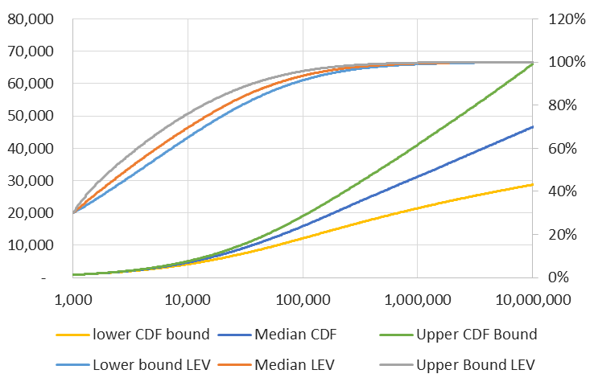
Estimating Ultimate CDF/LEV for a Typical Dataset
After MCMC we calculate fitted CDFs and LEVs with error bounds.
Of note is the level of error in the LEV (and therefore any ILF) for the upper layers.

Slide 41
Summary
Long tailed claims can be modelled as a distribution that changes through time to some ultimate position.
Each parameter of the distribution can be modelled through time using a growth curve.
A Lognormal distribution with a Pareto distribution acting in the tail may be useful for including treatment for extreme events seamlessly in your severity model.
Hierarchical models are useful for projecting undeveloped claims without development factors.
MCMC methods can provide reasonable measures of uncertainty for parameters such as portfolio ILFs.
Uncertainty in ILFs may then be useful for credibility based pricing for excess layers using frequency/severity models.

Slide 42
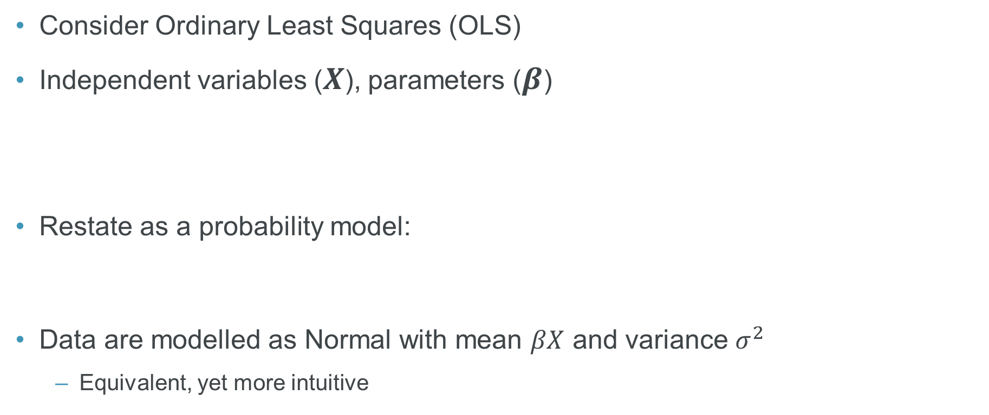

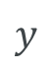

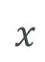
Getting started
Notes:
- Handover from Cy/summary
If you’re new to Bayesian methods, how do you get started?
Start basic
Simple linear model

Slide 43
Getting started
Consider the following auto claims data:
Potential linear model:
R implementation:
log_loss | lawyer | gender | seatbelt | age
3.6 | yes | male | yes | 50
2.4 | no | female | yes | 28
-1.1 | no | male | yes | 5
2.4 | yes | male | no | 32
-2.0 | no | male | yes | 30
… | … | … | … | …
model_lm <- lm(log_loss ~ lawyer + seatbelt + gender + age, data = data)
Notes:
Auto claims data (describe)
May try linear model

Slide 44
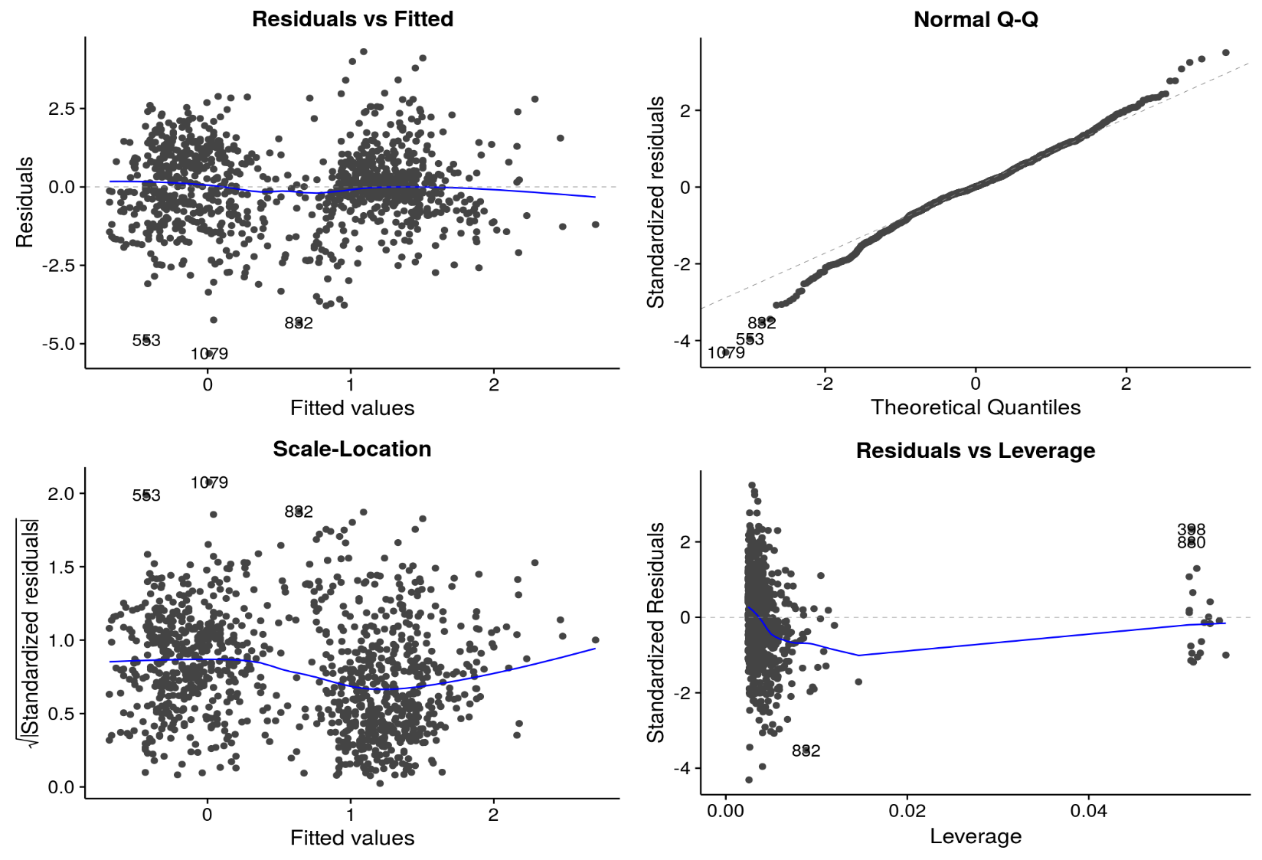
Getting started
Notes:
- Standard frequentist model diagnostics

Slide 45
Getting started
What if we’d like a Bayesian version?
Setting up from scratch in Stan → time/effort
R package ‘rstanarm’ reduces coding requirements
Pre-built Stan models (e.g. linear models, GLMs, ANOVA…)
R syntax relatively simple:
And offers various outputs…
model_stanlm <- stan_lm(log_loss ~ lawyer + seatbelt + gender + age, prior = R2(location = 0.8), data = data)
Notes:
May want fully Bayesian version…but little coding knowledge at this stage
Rstanarm takes away the coding pain for basic models
Variety of additional outputs as standard…

Slide 46
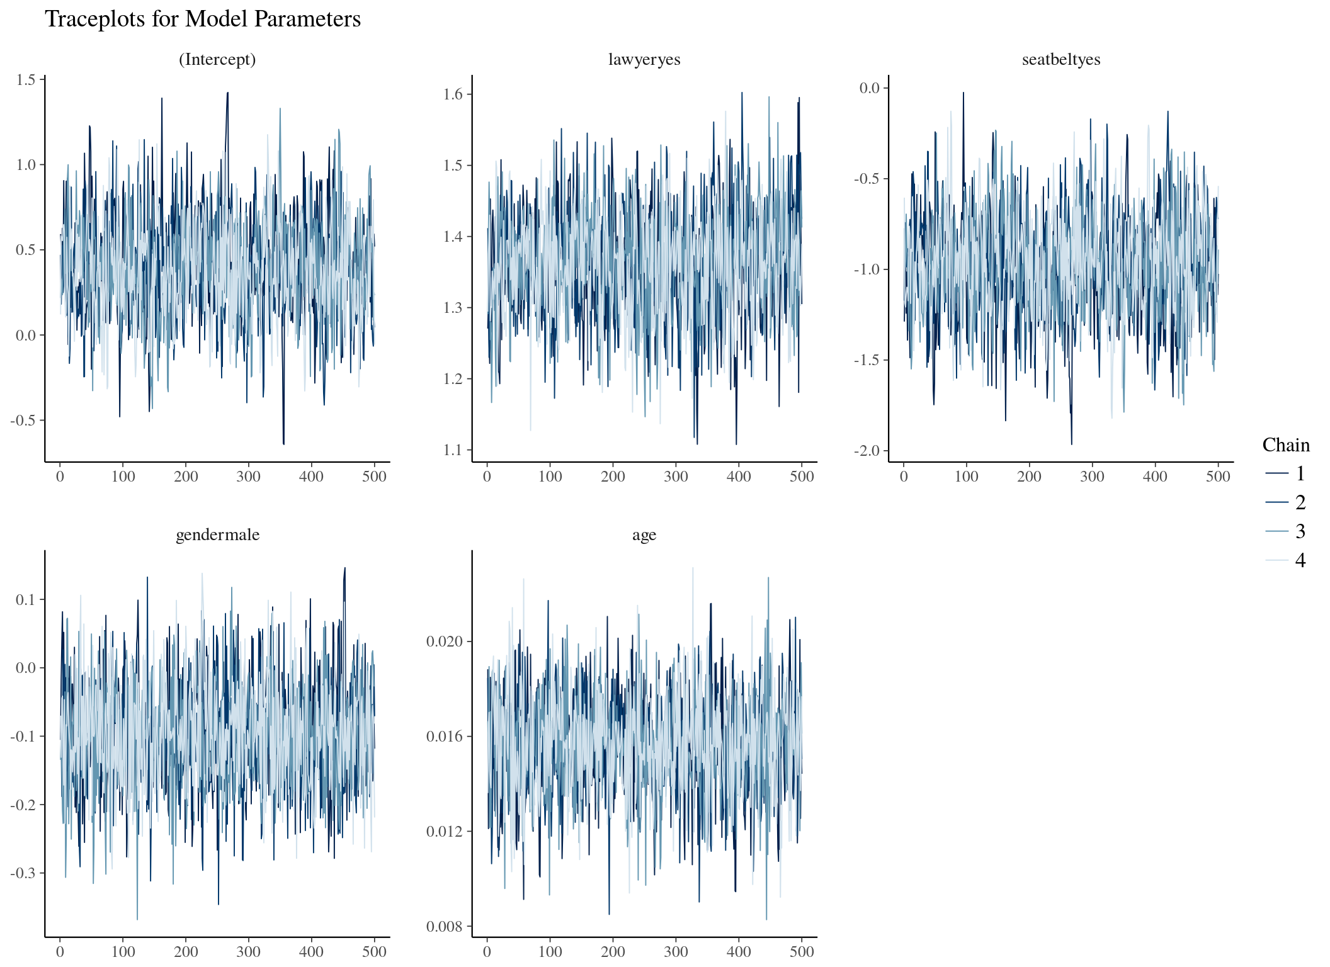
Getting started
Notes:
Traceplots to check convergence of model parameters – see that all have converged and are stable here

Slide 47
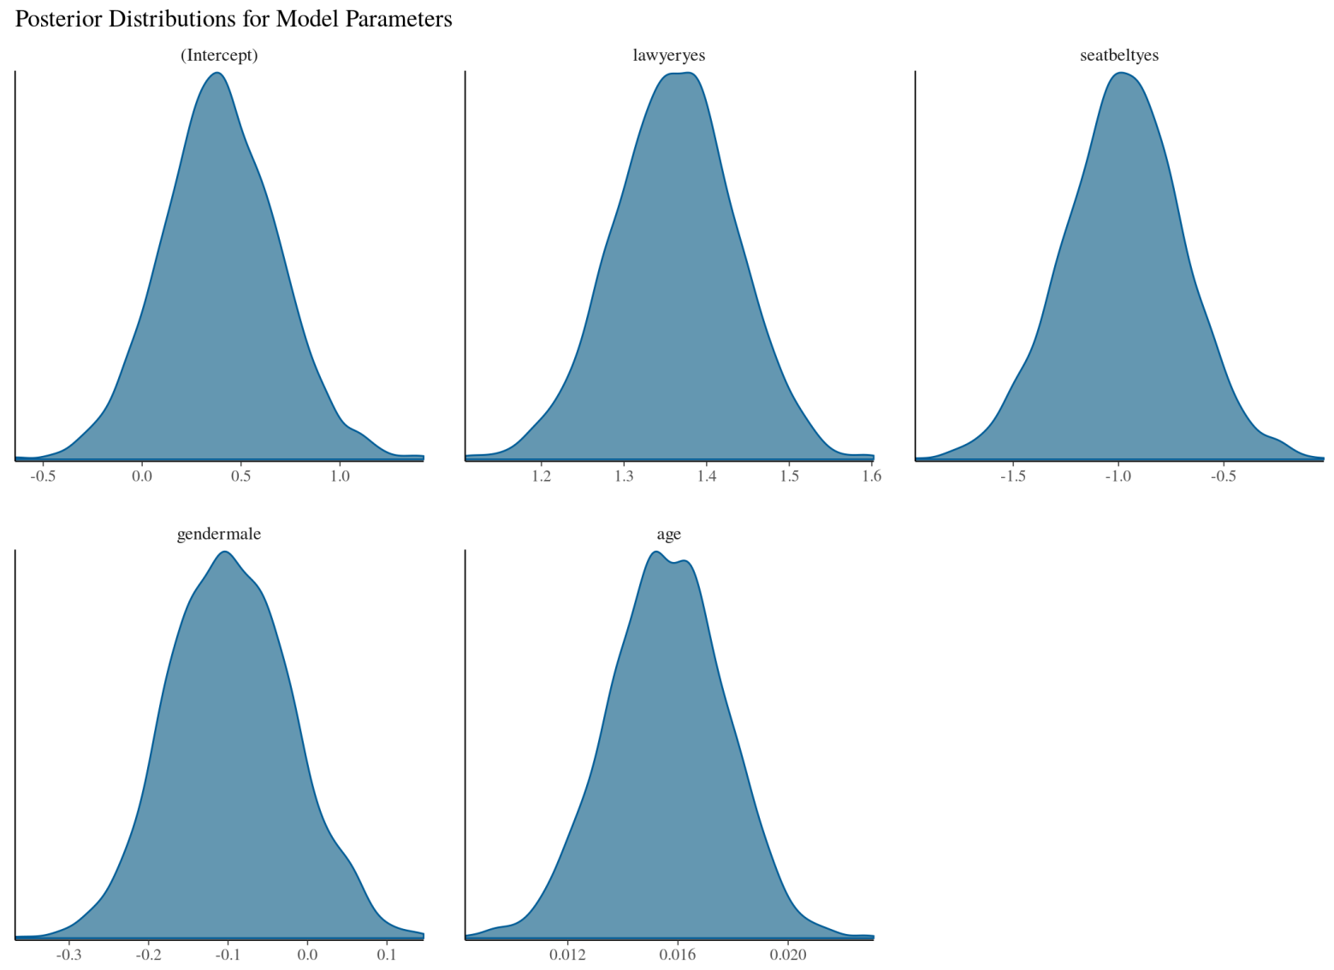
Getting started
Notes:
Posterior credibility intervals for parameter estimates
Uncertainty in parameter estimates conditional on having observed claims data

Slide 48
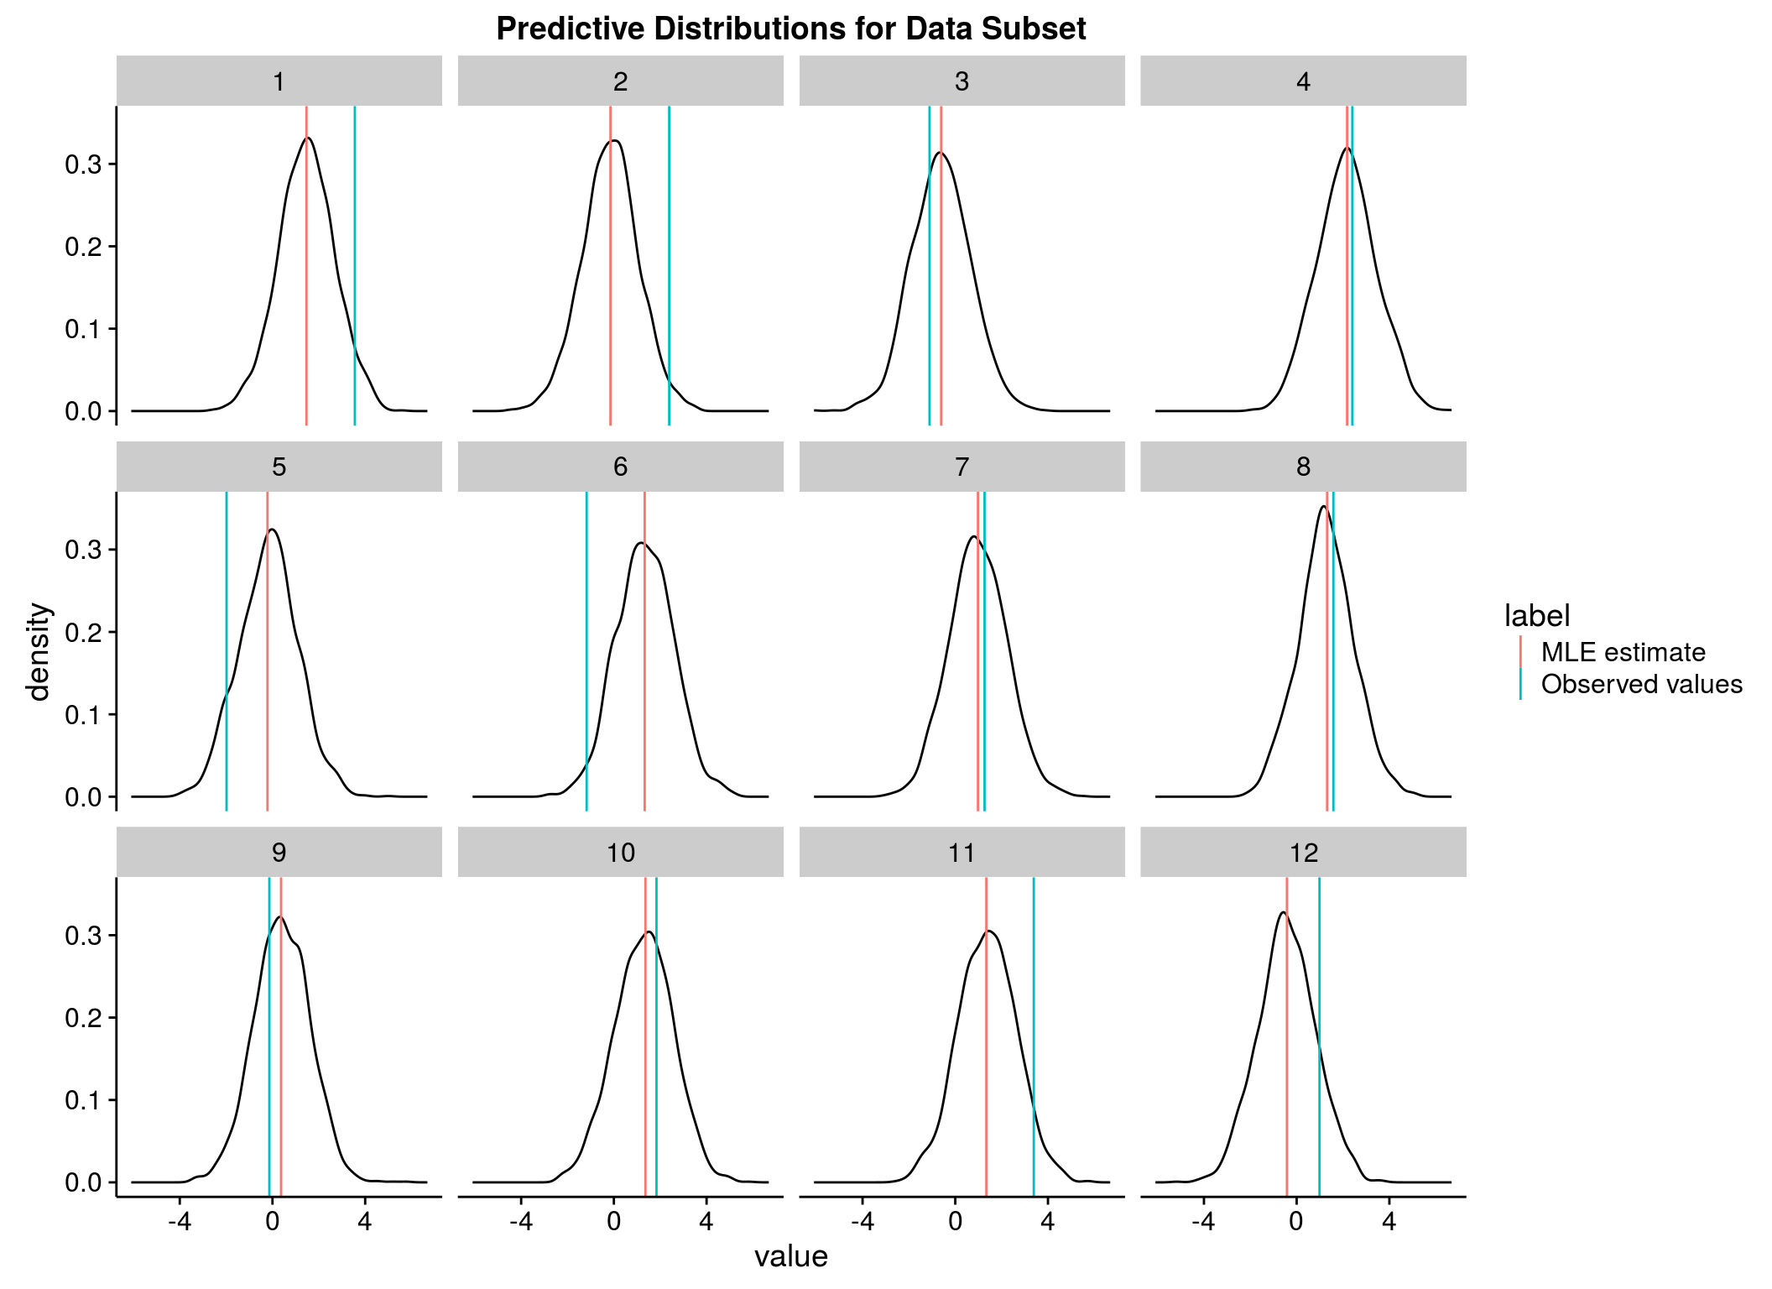
Getting started
Notes:
Posterior predictive distributions for individual claim values
i.e. given each claim’s characteristics, modelled probability distribution of final log(loss amount)
Centre of distributions similar to the MLE estimates
Some observed values are far away from MLE…BUT contained within posterior intervals
Therefore model reflecting uncertainty of predictions conditional on data observed

Slide 49
Conclusions
Bayesian methods can offer a variety of benefits
Reflect uncertainty, model flexibility, natural interpretation, hierarchical models, …
Numerous potential actuarial applications
Reserving, pricing, account segmentation, ...
Learning curve → rstanarm is a good place to start
“Scientific disciplines from astronomy to zoology are moving to Bayesian data analysis. We should be leaders of the move, not followers.”
- John K. Kruschke (2010)
Notes:
Bayesian approaches could enhance actuarial analyses in number of ways; particularly useful for small data
Mick and Cy demonstrated two potential applications, but there are more;
Learning curve, but fundamental concepts should be familiar to us
If new to Bayesian methods, recommend starting with rstanarm
Actuaries widely considered to be first Bayesian practitioners///

Slide 50
Further Reading
Hierarchical Growth Curve Models for Loss Reserving - Guszcza (CAS Forum 2008)
Hierarchical Compartmental Models for Loss Reserving - Morris (CAS E-Forum, Summer 2016)
On the Truncated Composite Lognormal-Pareto Model - Teodorescu (2009)
Doing Bayesian Data Analysis - John Kruschke
Statistical Rethinking - Richard McElreath
Data Analysis Using Regression and Multi-level/Hierarchical Models - Gelman and Hill
An Introduction to Statistical Learning - Tibshirani and Hastie
Stan Documentation - (tutorials, case studies, etc)
Modelling Loss Curves in Insurance with RStan (Stan Case Study) - Cooney
Notes:
actuarial work could benefit from Bayesian approaches in number of ways
Mick and Cy demonstrated just two potential applications, but there are more (some of which I’ve used myself at work)
There is a learning curve, but the fundamental concepts should be familiar to us
We recommend starting with rstanarm to start fitting Bayesian models
Final quote seems apt, given actuaries are widely considered to be the first Bayesian practitioners///

Slide 51
Questions
Comments
The views expressed in this [publication/presentation] are those of invited contributors and not necessarily those of the IFoA. The IFoA do not endorse any of the views stated, nor any claims or representations made in this [publication/presentation] and accept no responsibility or liability to any person for loss or damage suffered as a consequence of their placing reliance upon any view, claim or representation made in this [publication/presentation].
The information and expressions of opinion contained in this publication are not intended to be a comprehensive study, nor to provide actuarial advice or advice of any nature and should not be treated as a substitute for specific advice concerning individual situations. On no account may any part of this [publication/presentation] be reproduced without the written permission of the IFoA [or authors, in the case of non-IFoA research].

